Slide 1


Paralleled Facial Image Recognition Based On CNN Deep Learning CSYE7105-Group 9-Final Presentation
Group Members：
Yueheng LI
Director:
Dr. Handan Liu

Slide 2
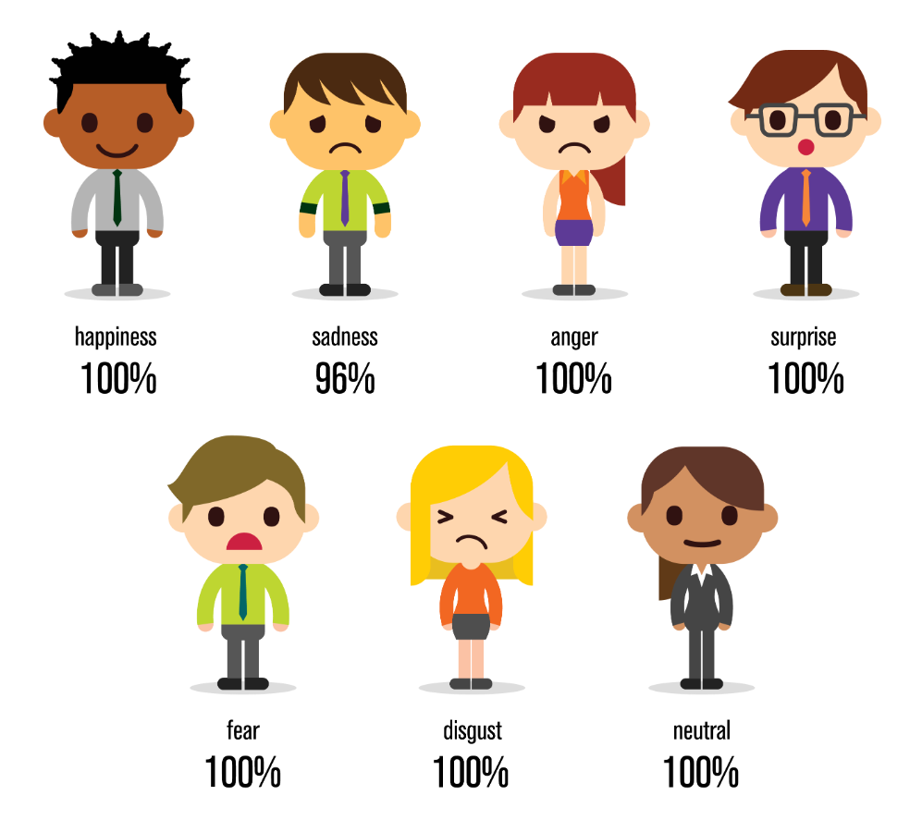
Background
Image recognition is one of the many applications of Machine Learning,
Facial Emotion Recognition (FER),as a branch of Image recognition, is the technology that analyses facial expressions from both static images and videos in order to reveal information on one’s emotional state.
Deep learning algorithms provide a way to process information without pre-defined features and make accurate predictions in the presence of changes in how features are expressed.

Slide 3

Motivation and Goals
Motivation
In this project, I will build a Machine Learning Algorithm using CNN to predict from a giving picture if the person is smiling or not.
And then, by using the parallelism method, for both data parallelism and model parallelism, I will compare execution runtimes for serial and parallel to show speed up.
Goals
Learn how to handle large scale dataset properly
Re-implement the process to make image classification based on Deep Learning
Do experiments on different platforms by using different parallelism methods
Compare different parallel methods and make brief conclusions

Slide 4
Workflow
Data Exploration Analysis
Load image data attributes in Dask format
Data Pre-Processing
Training, Validation and Test set
Pre-processing Images: Data Augmentation
Build up CNN deep learning model
Implement the model to do some predictions
Plot execution run times for serial and parallel parts to show speed up
Explore different parallel method
Comparison and Conclusion

Slide 5
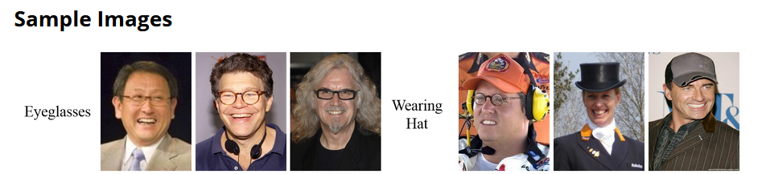
Dataset Description
CelebFaces Attributes Dataset (CelebA)(>1GB) is a large-scale face attributes dataset with more than 200K celebrity images, each with 40 attribute annotations. The images in this dataset cover large pose variations and background clutter. CelebA has large diversities, large quantities, and rich annotations, including:
10,177 number of identities,
202,599 number of face images
5 landmark locations, 40 binary attributes annotations per image.

Slide 6
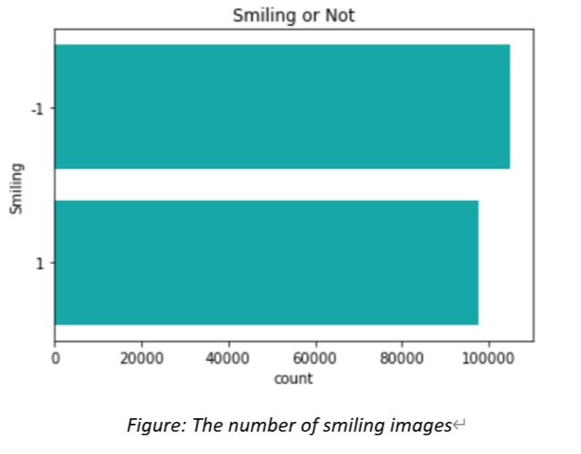
Exploratory Data Analysis of the dataset:

Slide 7
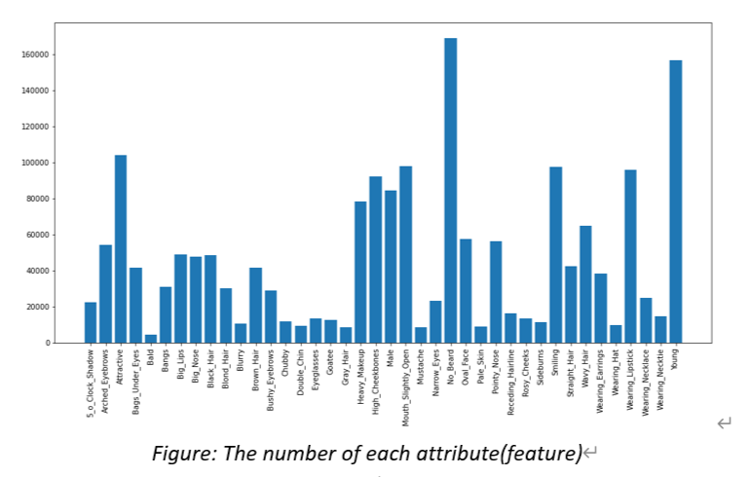
Exploratory Data Analysis of the dataset:

Slide 8
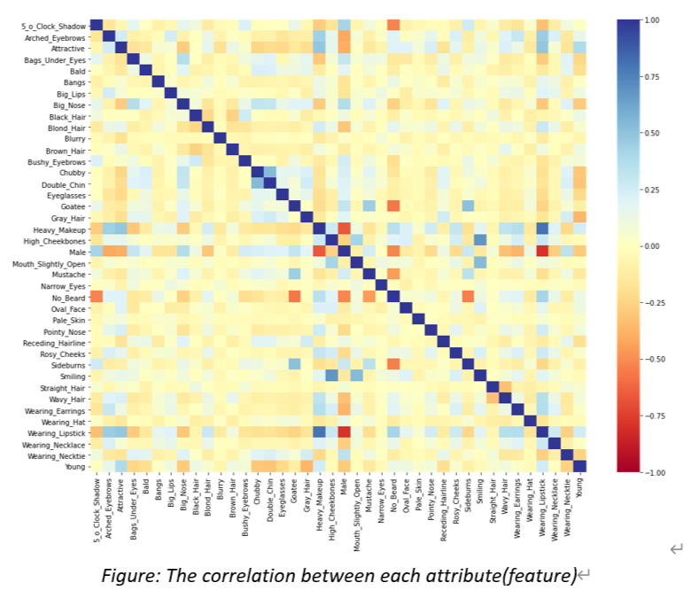
Exploratory Data Analysis of the dataset:

Slide 9
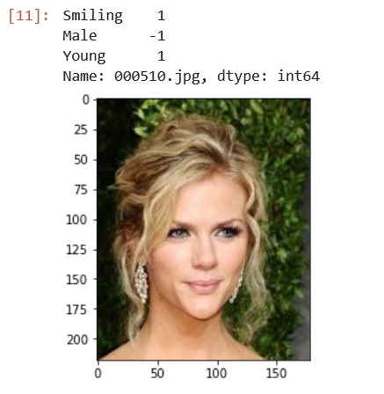
Exploratory Data Analysis of the dataset:

Slide 10
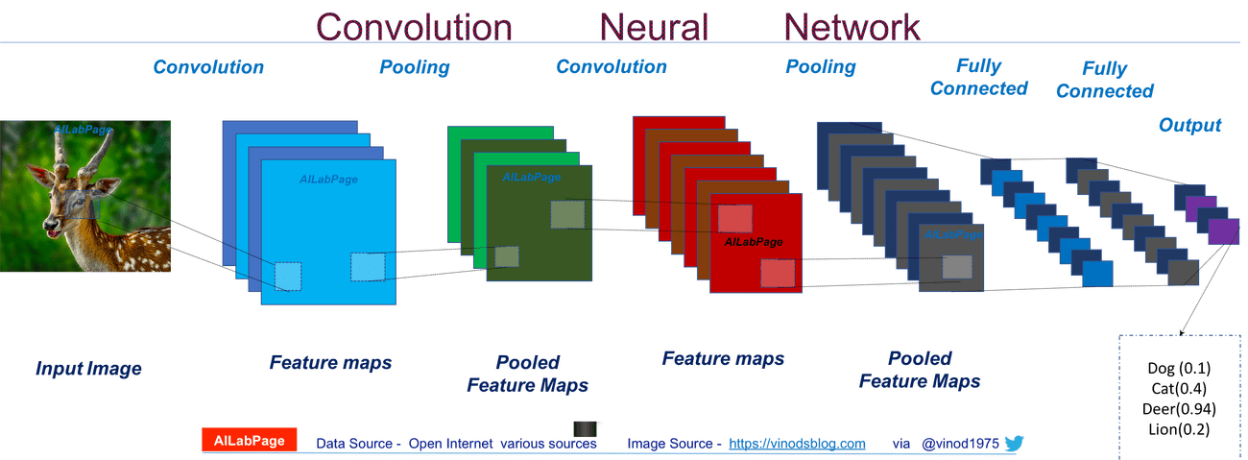
Model implementation
Convolutional Neural Network, also known as CNN
Is a well-known method in computer vision applications.
In my case, It is a class of deep neural networks that are used to analyze visual images.

Slide 11
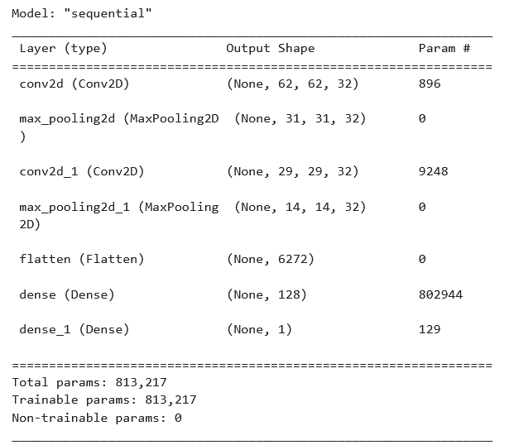
Model Construction: CNN model

Slide 12
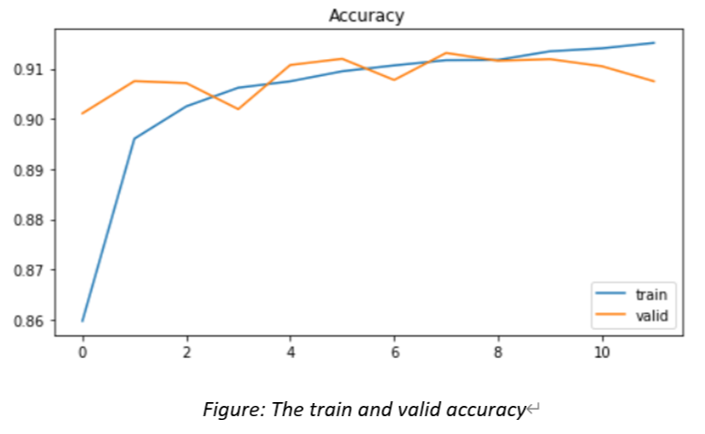
Model Performance analysis

Slide 13
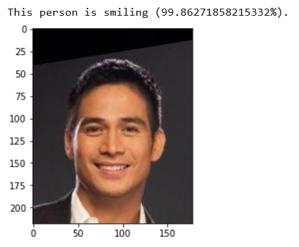
Make predictions

Slide 14
Environments
The local configuration of my PC：
CPU: Intel i7-10750H GPU:NVIDIA RTX2060 RAM:32GB
CUDA 11.4 + Tensorflow 2.5.0+Keras
2. OOD：
2x Core CPU + K80 GPU +8G RAM Using Tensorflow-GPU
CUDA 11.4 + Tensorflow 2.8.0 +Keras + anaconda2022/01
3. Discovery：
Most experiment conducted on GPU Node 1013：
2x Tesla V100-SXM2-32GB Tensorflow-GPU installed
CUDA 11.4 + Tensorflow 2.8.0 +Keras + anaconda2022/01

Slide 15

Parallelism Technology
Dask is a parallel computation framework that has seamless integration with Jupyter notebook.
Originally, it was built to overcome the storage limitations of a single machine and extend the computation capability of Pandas, Numpy, and Scit-kit Learn with DASK equivalents, but soon it found its use as a generic distributed system.

Slide 16
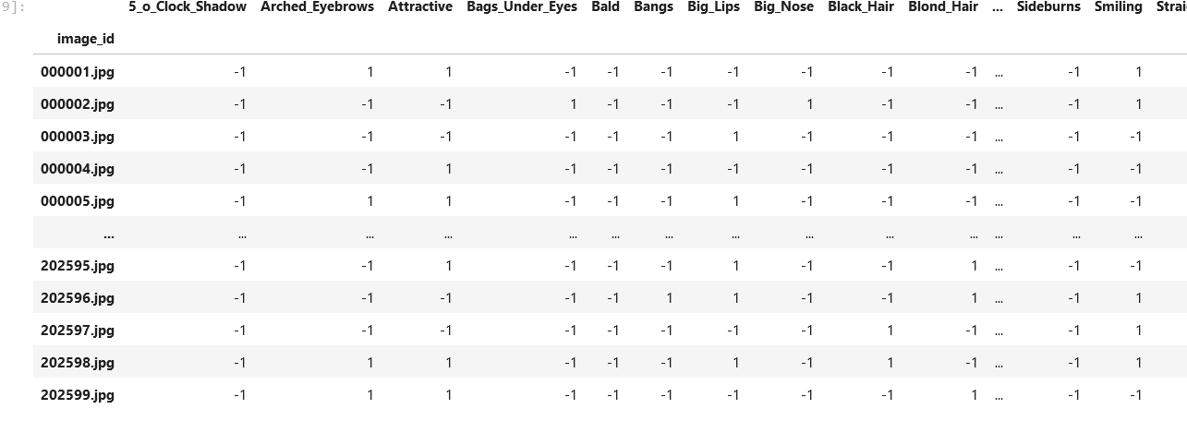
Data Parallel: Using Dask DataFrame

Slide 17
Parallelism Technology
tf.distribute.Strategy is a TensorFlow API to distribute training across multiple GPUs, multiple machines, or TPUs. Using this API, you can distribute your existing models and training code with minimal code changes. And it has been designed with these key goals in mind:
Easy to use and support multiple user segments, including researchers, machine learning engineers, etc.
Provide good performance out of the box.
Easy switching between strategies.
1.tf.distribute.OneDeviceStrategy(One GPU parallel)
This is a strategy to place all variables and computation on a single specified device.
2.tf.distribute.MirroredStrategy(Multi-GPU parallel)
It supports synchronous distributed training on multiple GPUs on one machine.

Slide 18
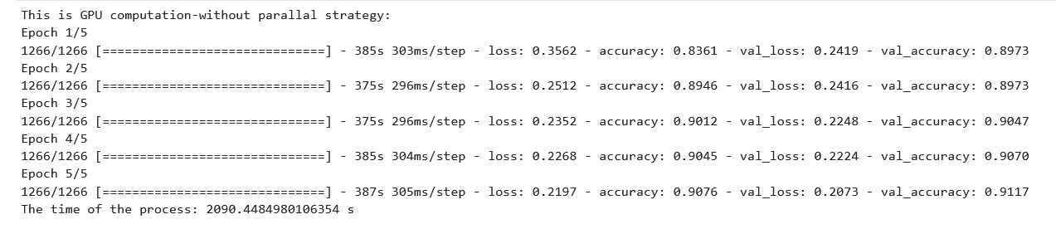
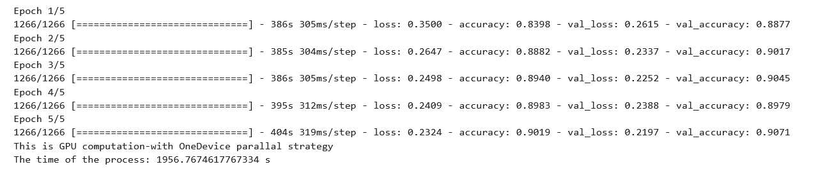
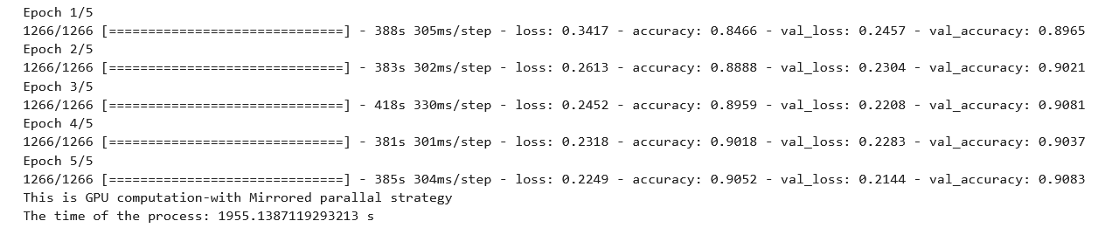
Model Parallel:(Single GPU)

Slide 19
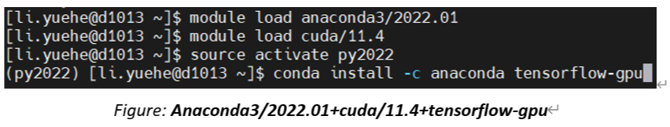
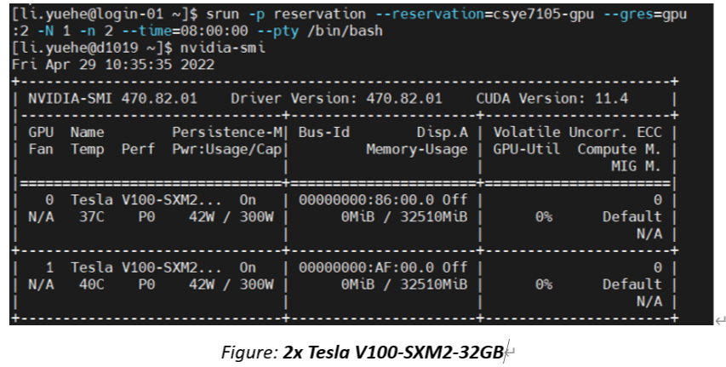
Data Parallel:(Multi-GPU)

Slide 20
Data Parallel:(Multi-GPU)

Slide 21
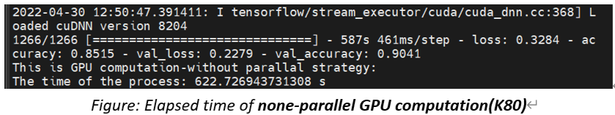
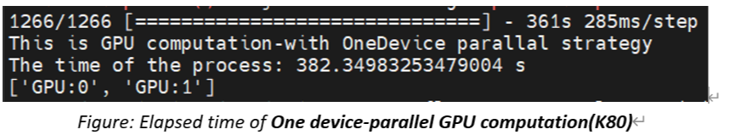
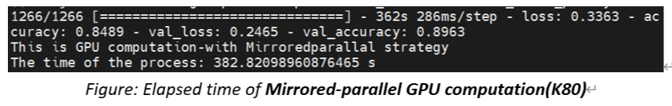
Data Parallel:(Multi-GPU)

Slide 22
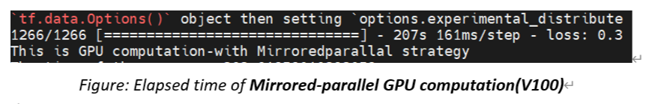
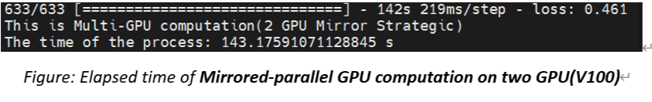
Data Parallel:(Multi-GPU)

Slide 23
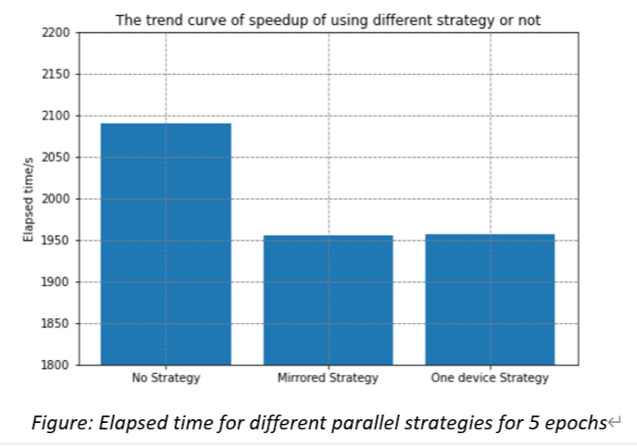

Conclusion

Slide 24
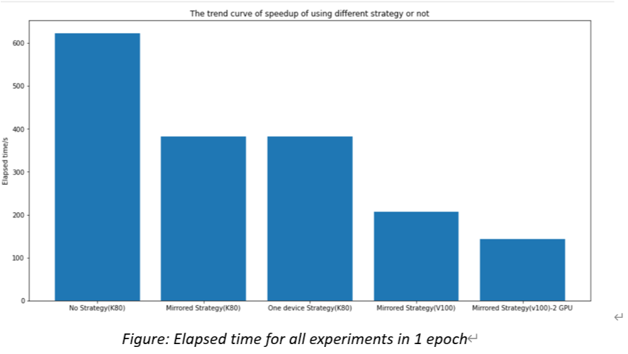
Conclusion

Slide 25
Conclusion
Both Data Parallelism and Model Parallelism can help gain speed up in parallel computing
Device computation power can hugely influence the computation speed.
The device(CPU or GPU) number can affect the computation speed.

Slide 26
4. Reference
1.Shashvat, G. (2020, July 18). Parallel processing in python using DASK - the Startup medium. TheStartup.https://medium.com/swlh/parallel-processing-in-python-using-dask
2.Working with GPUs — northeastern university research computing 2.0.0 documentation. (n.d.). Northeastern.Edu. Retrieved April 30, 2022, from https://rc-docs.northeastern.edu/en/latest/using-discovery/workingwithgpu.html
3.CelebA Dataset. (n.d.). Edu.Hk. Retrieved May 1, 2022, from http://mmlab.ie.cuhk.edu.hk/
projects/CelebA.html
4.Mandal, M. (2021, May 1). CNN for deep learning. Analytics Vidhya. https://www.analyticsvidhya.com/blog/2021/05/convolutional-neural-networks-cnn/
5.Karagiannakos, S. (2020, October 22). Distributed deep learning training: Model and data parallelism in tensorflow. AI Summer. https://theaisummer.com/distributed-training/
6.Keras Team. (n.d.). Multi-GPU and distributed training. Keras.Io. Retrieved May 1, 2022, from https://keras.io/guides/distributed_training/
7.TensorFlow 1.0. (n.d.). Effectivemachinelearning.Com. Retrieved May 1, 2022, from https://effectivemachinelearning.com/TensorFlow_1.0/10._Multi-GPU_processing_with_data_parallelism
8.CNRS. (n.d.). IDRIS - TensorFlow: Multi-GPU and multi-node data parallelism. Idris.fr. Retrieved May 1, 2022, from http://www.idris.fr/eng/jean-zay/gpu/jean-zay-gpu-tf-multi-eng.html

Slide 27
Thanks for
listening!!!

